Slide 1
The Importance of Culture-Based Education in Indonesia: A Case of Paguyuban Pasundan, West Java
Ahman Sya
Muhammad Zid
Department of Geography, Faculty of Social Sciences, State University of Jakarta
Notes:
Your introductory or title slide should convey the overall “feeling” and focus of your presentation. For instance, I typically present about small-business trends, new business ideas, growth opportunities or other positive trends. In this sample presentation, I’m talking about new business ideas, so I used a sun graphic in this slide template to convey a positive feeling. Personalize this slide template with your company’s logo.
To add a logo to all slides, place it on the Slide Master. To access the Slide Master, on the Themes tab of the Ribbon, click Edit Master and then click Slide Master.
Disclaimer: You understand that Microsoft does not endorse or control the content provided in the following presentation. Microsoft provides this content to you for informational purposes only; it is not intended to be relied upon as business or financial advice. Microsoft does not guarantee or otherwise warrant the accuracy or validity of this information and encourages you to consult with a business or financial professional as appropriate.
RIEVA LESONSKY
Founder and President, GrowBiz Media
Rieva Lesonsky is founder and president of GrowBiz Media, a content and consulting company specializing in covering small businesses and entrepreneurship. A nationally known speaker and authority on entrepreneurship, Lesonsky has been covering America’s entrepreneurs for nearly 30 years. Before co-founding GrowBiz Media, Lesonsky was Editorial Director of Entrepreneur Magazine.

Slide 2
INTRODUCTION
The implementation of culture-based education in Indonesia is not something new.
Since the first cultural congress in Bandung (1951), and the third in Solo (1954), a correlation between national education system and culture has always be an important topic.
It is believed that applying cultural values in educational processes has a positive effect on several elements.
Notes:
Insert a chart in this slide template to illustrate your topic visually, then use bullets or color to call out key findings or points from your chart in a brief format.

Slide 3
THE MAIN PROBLEM
1.How to create an alternative models of formal education (culture-based education), especially to anticipate and prepare the well-educated generation for the future development of Indonesia?
2. How to maintain teaching and learning process at the culture-based education?

Slide 4
Indonesia is the world’s largest archipelago (consisting of 17.504 islands).
525 ethnics group.
250 local languages.
The most populated in ASEAN countries (267 million, and number 4 in the world).
Total area 8,3 million square kilometers (70% is seas, 30% land).
Pancasila, unity in diversity.
The General Information of Indonesia
Notes:
I like to speak spontaneously, so I use PowerPoint as an outline to keep me on track. It’s best to keep your PowerPoint text brief, simply reinforcing key points you will talk about at more length. You can use this slide template to convey a series of steps or related points in a short format.

Slide 5
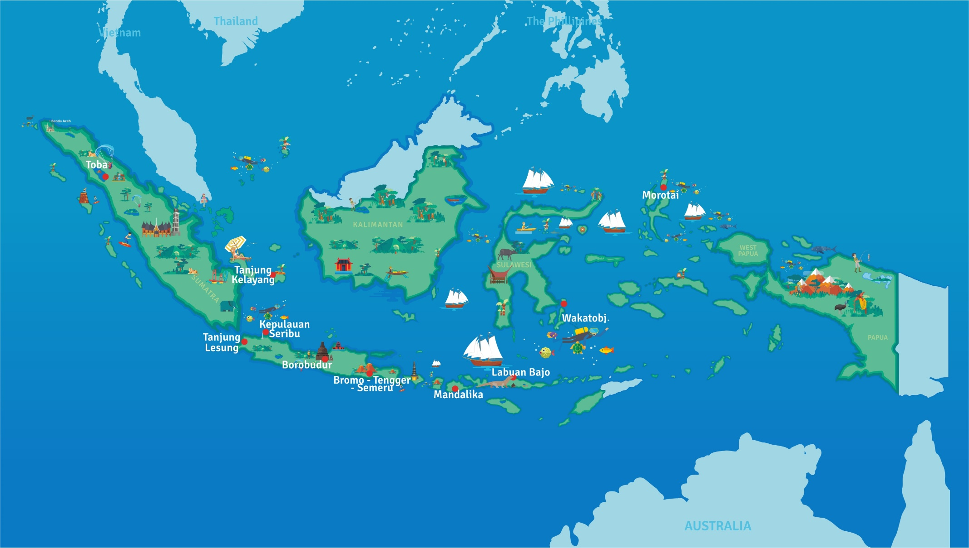
Peta potensi pariwisata Indonesia
REPUBLIC OF INDONESIA
17.504 Islands
2. 525 Ethnics group
3. 250 Local languages 4. 267 Million of populations
5. 70 : 30 (Seas : Lands)
6. 8,3 Million square kilometers ( Rondo Isl – Merauke /W-E, Marore Isl- Dana Isl/N-S)
7. At the meeting of three world plates (Asian, Indo-Australian, Pacific)
8. Past through “the ring of energy”, cirkum Mediterania and Pacific.

Slide 6
The role of formal education
The role of formal education in Indonesia is as the main infrastructure for cultural transformation and building humanism.
The concept of nurture in education is one of the important things of culture-based education.
It nurtures the sense of belonging, identity, and strengthens community participation; it also promotes appreciation and understanding of history and cultural heritage.
Therefore, we should prepare alternative models of formal education especially to anticipate and prepare the well-educated generation for the future development of Indonesia.
Notes:
This slide template can show steps, stages or how various elements or factors combine to make one key result or goal. For instance, you could show how various departments in your business work together to make the sale, how key customer groups will all purchase your product, or how different funding sources will provide the total you need. This slide template also makes an excellent concluding slide for your presentation, enabling you to graphically sum up your key points into one final whole.

Slide 7
Cultural heritage and culture-based education
Is not only about old things but also about new objects, practices and places holding cultural values for recent generations.
The crucial role of the communities culture carriers in teaching and learning process should be maintained.
A sense of responsibility in valuing, developing, and protecting the environment is inculcated in children (this is a part of sustainable knowledge).
Students develop competencies and cultural skills required for interacting with people around the world.
The culture instills the sense of national pride and develops an individual’s identity as a nation.
Preserving the cultural memory will lead to a greater understanding of the nation’s calling in the global society and community of nations.

Slide 8
A Case of Paguyuban Pasundan
Paguyuban Pasundan is Sundanese ethnic organization like NGO), focuses on cultural activities including to preserve the Sundanese culture.
This is the oldest cultural organization which is still active in Indonesia (founded on July 20, 1913).
Paguyuban Pasundan takes role in the field of education, socio-cultural, politics, economy, youth and woman empowerment.
Today, Paguyuban Pasundan has 32 branch offices with 492 smaller brances, 118 Pasundan schools (primary and secondary level, and four universities.
The headquarter of Paguyuban Pasundan is at Jalan Sumatera 41, Bandung.

Slide 9
A characteristics of Teaching and Learning at Paguyuban Pasundan
1. Reinforce the learning student and help them attain high academic performance.
2. A teaching guide using culture-based pedagogy (for primary and secondary schools), and andragogy for universities.
3. This is part of local content development at the national curriculum system for primary and secondary education.
4. Curriculum content is as follows: Sundanese language, arts, ethics, history, and tradition.
5. The goals: (1) may serve as a new flavor that can uplift interest towards the subject, (2) This can lead learners to a strong connection between classroom learning experiences and their way of life, (3) develop a spirit of patriotism, nationalism, and cultivate their strong sense of belongingness to the community.
6. All this (No. 5) will lead to an optimistic change to the nation.

Slide 10
Culture-Based Education
Culture plays a noteworthy role in teaching and learning process and serves as the source of the teacher’s motivation and creativity in teaching methodologies and approaches.
Culture directs the behavior of mankind and its complex form from the history of ancient civilizations inherited to generations.
In order to improve the educational process, there is a need to cope up with the challenges and stand out among others.

Slide 11
Culture Behavior and Education
Culture-conscious human: Every conscious human behavior has an intentions because it comes from his mind, namely creativity, passion, and emotion, that are only possessed by humans. Behavioral intention is determined by opportunities in the surrounding structure of experience of the human. Awareness of the structure will greatly support the desired behavior and the possibility of restructuring the world experience itself (this is the basis of change and cultural development).
Civilized humans: Culture-conscious humans are the beginning of focused and creative cultural actions. Without awareness of culture, it is impossible for humans to become civilized.
Culture expert in a wider context: They are cultural role models, including leaders in various aspects of life.

Slide 12
Governance
To accomplish cultural-based education at the national level, commitment between central and regional governments as well as all traditional/tribal leaders is needed so that the local content related to culture and customs becomes a subject in the formal education process.
Aside from the central and regional governments, holistic supports are also needed from educators/scholars, business, communities, and the media.
The successful management of culture-based education will be a shared task and responsibility.

Slide 13
The Indonesians develop a great understanding, awareness, and appreciation of their history, arts, heritage, and geography towards the perception that will enhance the quality of life. With the implementation of culture-based education, the Indonesians envisions to progress as a nation of culturally empowered and literate people who are committed to be patriotic and nationalist global citizens.
Conclusion
Notes:
I often use color and graphics to add excitement to a presentation. Just because it’s about business doesn’t mean it has to be staid—you need movement, energy and color, as in this slide template. Use this slide template to illustrate relationships or processes. In this slide, I used it to show how demographic trends create a new consumer group and what products that group purchases. You could also use it to illustrate your sales cycle or relationships among departments in your company.

Slide 14
Culture-based education:
Culture is the foundation of education
Culture is the main factor for sustainable development
Governance
Culture provides perspective, methodology, principle, assessment, framework and evaluation upon which abilities, skills, and knowledge regarding a person and the world are disseminated.
Notes:
A plain old bulleted list can get boring, so use graphics to liven it up. An image that conveys what you’re saying in visual format (like this diagram) can reinforce your ideas in the audience’s mind.

Slide 15
Inside the education based on the culture
Students learn the unique values, heritage, language, experiences of the community, etc.
There are more than 74 million children
under age 18 living in the U.S.
Notes:
I like to use an off-balance layout to keep things from getting too symmetrical. Customize this slide template graphics of your choice, including photos, clip art, your logo or illustrations. Good photos really help cement an idea in the audience’s mind.
This slide is animated to display an appropriate image as you introduce each business type.

