Slide 1
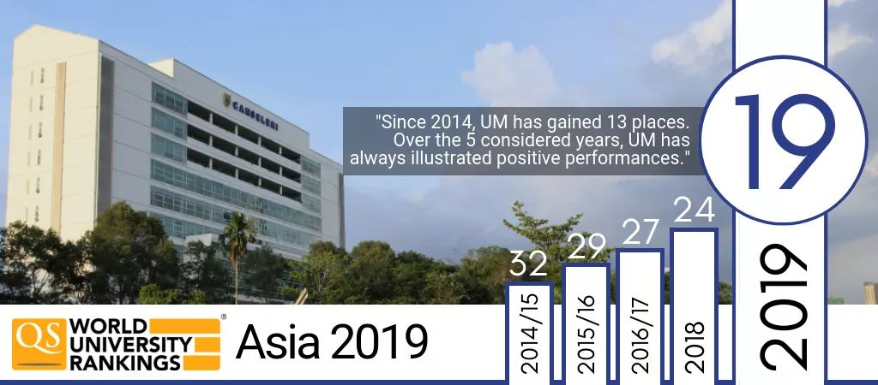
Writing Good Article for International Indexed Journal/Proceeding
Associate Professor Dr. Ahmad Zabidi Abdul Razak
Deputy Dean (Research and Development)
Faculty of Education
University of Malaya
Kuala Lumpur
Malaysia
E-mail: zabidi@um.edu.my

Slide 2
INTRODUCTION
Concept of good article
International Indexed Journal/Proceeding

Slide 3
CONCEPT OF GOOD JOURNAL
Identify your target journal
Use the target journal guidelines
Understand your target readers
Clear problem statement
Support your statements with citation/references
Notes:
In conclusion, from the origin of 81 items, the EFA Analysis identified only 43 items can be used to measure suitability aspects of Life-Long Learning. The findings also showed that ranking aspect that encouraged of Life-Long learning as follow;
Feasibility of time and venue
Content of Life-Long Learning coursework
Economy and finance
Usage of ICT for Life-Long Learning
Educators
Workplace environment
Method of the implementation of Life-Long Learning
Assessment of Life-Long Learning
Social aspects
Education policy

Slide 4
Guide your readers with analytic-rationale (logical flow of writing and structure)
Clear, Logical and Concise.
Use short and sharp sentences
One point/idea per sentence
One main idea and description in one paragraph
Coherence for the next paragraph

Slide 5
Do not use words that does not add value to your writing. Can delete the words without changing the meaning of the sentence.
Never assume your reader know what you do – need to provide enough information

Slide 6
Suitable research methodology, methods, population, sampling, sample, instruments, validity, reliability, advanced data analysis, findings, discussion, conclusions and recommendations
New contributions

Slide 7
Area - Instructions
Developing - Partial of instructions and requirements are followed.
Good - Majority of instructions and requirements are followed.
Strong - All instructions and requirements are followed. One minor detail is missing
Exceptional - All instructions and requirements are followed.

Slide 8
Area - Content
Developing - Contents are unfocused. Few statements are supported by references.
Good - Contents are less focused and inconsistent. Some statements are supported by references.
Strong - Contents are less focused and inconsistent. Some statements are supported by references.
Exceptional - Contents are focused on consistently, clearly and effectively. Statements are supported by references.

Slide 9
Area - Organization
Developing - Context and purpose are not established in the introduction. Few paragraphs begin with a topic sentence that supports content. Smooth transitional sentences connect with few paragraphs.
Good - Context and purpose are made partially clear in the introduction. Some paragraphs begin with a topic sentence that supports content. Smooth transitional sentences connect with some paragraphs.

Slide 10
Strong - Context and purpose are made clear in the introduction. Most paragraphs begin with a topic sentence that supports the content. Smooth transitional sentences connect with most paragraphs.
Exceptional - Context and purpose are made clear in introduction. Paragraphs begin with a topic sentence that supports the content. Smooth transitional sentences connect with paragraphs.

Slide 11
Area - Writing style
Developing - There are varieties in sentence structure, numerous spelling and grammar errors.
Good - Sentence structure is elementary. Errors in grammar, poor word choice, poorly proofread
Strong - Sentence structure is somewhat varied. A few grammar or spelling errors
Exceptional - Sentence structure is varied throughout the paper. Negligible errors in spelling and grammar.

Slide 12
International Indexed Journal/Proceeding
WoS – ISI
Scopus
MOJEM

Slide 13
THANK YOU

