Slide 1
TREND OF THE GEOGRAPHY EDUCATION CURRICULUM DEVELOPMENT
By: MUKMINAN
FSS-YSU (FIS-UNY)

Slide 2
INTRODUCTION
The opening of the 1945 Constitution mandates the four objectives of the
Unitary State of the Republic of Indonesia (NKRI),
namely: protecting the entire territory of Indonesia and the entire territory of Indonesia's bloodshed, advancing public welfare, educating the nation's life, and participating in carrying out world order based on independence, eternal peace and social justice.
FIS UNY

Slide 3
INTRODUCTION
Law Number 20 of 2003 concerning the National Education System, Article 1 number 1 states that education is a conscious and planned effort to create a learning atmosphere and learning process so that students actively develop their potential to have religious, spiritual power, self-control, personality, intelligence, noble character, and skills needed by him, society, nation and country. To realize this goal, while preparing a competent generation according to the demands of development. The steps that need to be taken, one of which is to develop the curriculum from time to time, as well as the Curriculum of Social Sciences Education, including Geography Education.

Slide 4
URGENCY OF GEOGRAPHY EDUCATION CURRICULUM DEVELOPMENT
Graduates will thus be able to contribute to meet the needs of a dignified nation at the local, national, regional and international levels for existing resources with Science, Technology, Engineering and Mathematics (STEM) and support the Sustainable Development Goals (SDGs).
FIS UNY

Slide 5
CURRICULUM DEVELOPMENT
Curriculum Interpretation
In the existing Laws and Government Regulations, the curriculum is a set of plans and arrangements regarding the objectives, content, and learning the material and the methods used as guidelines for implementing learning activities to achieve specific educational goals (Law No. 20/2003 and PP no. 19/2005 which was improved with PP no.32/ 2013)
FIS UNY

Slide 6
WHY CURRICULUM MUST BE DELIVERY DEVELOPED ?
There are several reasons why the curriculum is continually being developed, including:
Development of Science and Technology (ITS), as well as Social Change
Human and Life Missions
Related to:
Humans as creatures of God, have the nature to seek truth, goodness, and beauty;
Humans have multi-intelligence;
Humans must live respectfully and respectfully
Which includes:
Science and technology and the art of changing lifestyles and creating changes in the global order of life;
The change occurs quickly and continuously; and
We need loyalty to values and identities by staying open, adaptive, and creative in change
FIS UNY

Slide 7
WHY CURRICULUM MUST BE DELIVERY DEVELOPED ?
There are several reasons why the curriculum is continually being developed, including:
Empirical Experience
The Need for Change in Mindset
Complaints from various parties, such as Number of courses or subjects; material content; solid learning hours; the need to establish Graduate Competency Standards or Learning Outcomes that are appropriate to the needs.
This change in mindset must be adapted to the challenges of the 21st Century, which was characterized by the Industrial Revolution 4.0
FIS UNY

Slide 8
INDONESIA NATIONAL QUALIFICATION FRAMEWORK (KKNI)
is a competency qualification framework that can juxtapose, equalize and integrate between the fields of education and the field of job training and work experience in order to provide recognition of work competencies following the structure of work in various sectors (ps.1 v. 1);
2. Is an embodiment of the quality and identity of the Indonesian Nation concerning the national education and training system owned by Indonesia.
3. Consists of 9 (nine) qualification levels, starting from Qualification 1 as the lowest qualification and qualification - 9 as the highest qualification;
4. The level of qualification is the level of learning achievement agreed nationally, arranged based on the results of education or training obtained through formal, non-formal, informal, or work experience;
5. With the issuance of Presidential Regulation No. 8 of 2012, then every tertiary institution, including the LPTK (Educational Personnel Education Institution) must certainly formulate a KKNI-based study program curriculum.
1
2
3
4
5

Slide 9
DEVELOPMENT OF THE CONCEPT OF GEOGRAPHY AS A SCIENtific DISCIPLINE
The concept of geography as a science has continued to develop and experience the development of paradigms in an increasingly practical direction.
Worosuprojo [2013] states:
the development of science provides a new perspective for geography in the development of dynamic methodologies, analyzes, and scientific frameworks.
Meanwhile, Riyanto [2013] :
the development of Geography as a systematic science has placed Geography as a science whose existence is increasingly needed by the community, because at the praxis level there is a greater opportunity to be involved as applied science that contributes to development.
FIS UNY

Slide 10
DEVELOPMENT OF THE CONCEPT OF GEOGRAPHY AS A SCIENTIFIC DISCIPLINE
Hopkin [2011] states:
geography teaches about changes in progress that can lead a literate citizen of a globally connected world.
Lambert and Morgan [2010] call:
modern geography predicted to create an era of harmony and stability through the focus of spatial studies and human activity on earth. This condition should be known and understood by the community as an effort to preserve the natural place of life. Preservation efforts can be given programmed within the scope of the school through integration in geography teaching/instruction and other lessons/cources.
FIS UNY

Slide 11
DEVELOPMENT OF THE CONCEPT OF GEOGRAPHY AS a SCIENtifiC DISCIPLINE
Mohan et al. [2015] explained:
geography is a complex scientific discipline that focuses on the characteristics, relationships, and spatial patterns of human and natural activities. Geography teaches about culture, geopolitics, natural systems, distribution of resources and their use, and mapping of spatial data to better understand the world.
Withers, [2009] added that geography cannot be separated from the process of time and "place" as one of the most fundamental concepts in geography.
Janelle and Goodchild [2010] state:
geography does not only use conventional maps in explaining a phenomenon, but now can use remote sensing and Geographic Information System (GIS).
The geographical dimension as a learning product is made clear by Anthamatten [2010], Lee and Bednarz [2012], that geography learning designs students to develop several spatial thinking abilities. The application of spatial concepts, such as location, distance, scale, distribution, and patterns, makes spatial thinking as characteristic of geographic thinking.
FIS UNY

Slide 12
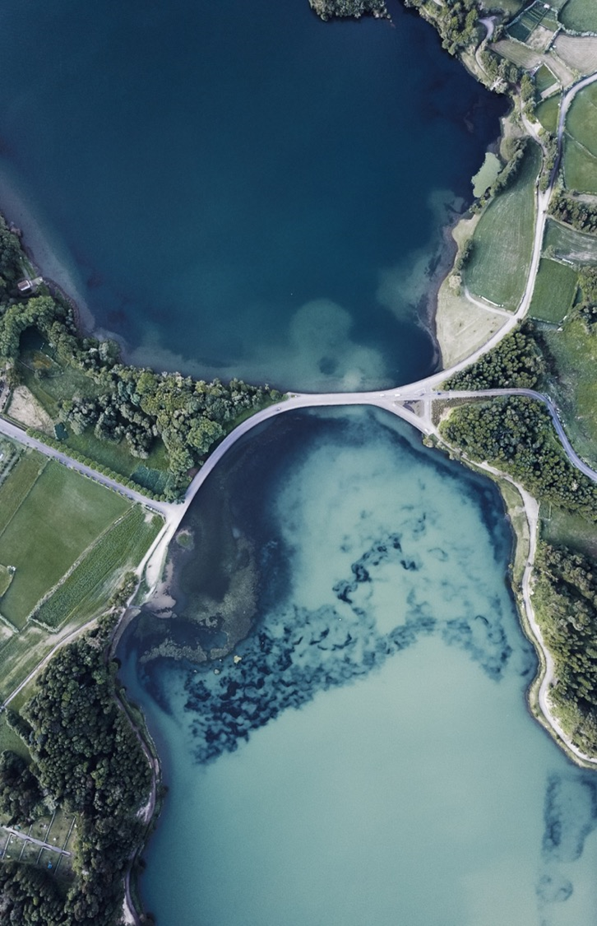
TREND OF GEOGRAPHY EDUCATION CURRICULUM DEVELOPMENT
1. The spirit of Indonesians
The spirit of Indonesians is characterized by "Four pillars of the life of nation and state", namely:
(1) Pancasila,
(2) 1945 Constitution,
(3) Bhinneka Tunggal Ika and
(4), The Unitary State of the Republic of Indonesia is "Dead Prices "Which cannot be negotiated.
Therefore, the old paradigm in Geography teaching that is often spoken by our teachers is related to the position of sea or strait waters, such as: "The Sunda Strait that separates the island of Java from Sumatra" would have been incompatible with the current era and must be adjusted to "The Sunda Strait is connecting the island of Java with Sumatra".
Likewise, with the seas and other straits.

Slide 13
TREND OF GEOGRAPHY EDUCATION CURRICULUM DEVELOPMENT
The spirit of Indonesians: Continue
School level Curriculum ! ! !
Kelompok | SD/MI | SMP/MTs. | SMA/MA
Kel-A | 1. Pendidikan Agama dan Budi Pekerti | 1. Pendidikan Agama dan Budi Pekerti | 1. Pendidikan Agama dan Budi Pekerti
 | 2. PPKn. | 2. PPKn. | 2. PPKn.
 | 3. Bahasa Indonesia | 3. Bahasa Indonesia | 3. Bahasa Indonesia
 | 4. Matematika | 4. Matematika | 4. Matematika
 | 5. Ilmu Pengetahuan Alam | 5. Ilmu Pengetahuan Alam | 5. Sejarah Indonesia
 | 6. Ilmu Pengetahuan Sosial | 6. Ilmu Pengetahuan Sosial | Geografi Indonesia
 |  | 7. Bahasa Inggris | 6. Bahasa Inggris
Kel-B | 7. Seni Budaya dan Prakarya | 8. Seni Budaya | 7. Seni Budaya
 | 8. Pend Jas, OR, dan Kes. (Penjasorkes) | 9. Penjasorkes | 8. Penjasorkes
 |  | 10. Prakarya | 9. Prakarya dan Kewirausahaan
Kel-C (Pmnt)
MIA |  |  | 1. Matematika
 |  |  | 2. Biologi
 |  |  | 3. Fisika
 |  |  | 4. Kimia
IIS |  |  | 1. Geografi
 |  |  | 2. Sejarah
 |  |  | 3. Sosiologi
 |  |  | 4. Ekonomi
Bhs n Bdy |  |  | 1. Bahasa dan Sastra Indonesia
 |  |  | 2. Bahasa dan Sastra Inggris
 |  |  | 3. Bahasa Asing Lain (Arab, Mandarin, Jepang, Korea, Jerman, Perancis)
 |  |  | 4. Antropologi

Slide 14
TREND OF GEOGRAPHY EDUCATION CURRICULUM DEVELOPMENT
2. Strengthening Character Education (PPK).
PPK is based on Presidential Regulation (Perpres) Number: 87 of 2017 concerning Strengthening Character Education.
The Ministry of Education and Culture also prepares a Ministerial Regulation (Permen), which is derived from the Presidential Regulation on Character Education Strengthening (PPK).
Updated Indonesian map
The Maritime Affairs Coordinating Ministry (Kemenko) on July 14, 2017, has announced the start of the publication of a new map of the NKRI.
Some changes to the map followed several regional boundary agreements with neighboring countries.
The latest 2017 NKRI map, one of which can be seen in figure: Geospatial Information Agency (BIG).

Slide 15
TREND OF GEOGRAPHY EDUCATION CURRICULUM DEVELOPMENT
4. Scientific Approach
which is an approach to learning/instruction that includes: observing, asking, gathering information, associating, and communicating (5M).
5. XXI Century Learning Paradigm
The 21st-century learning paradigm (4C or 4K) reflects four things that must be implemented in each learning activity, namely: (1) Critical Thinking and Problem Solving, (2) Creativity and Innovation (3) Communication (4) Collaboration, .... or 4K
6. STEM (Science, Technology, Engineering and Mathematics)
From the scientific perspective, STEM as a system, can be studied from various perspectives such as Education, Social and Economic.
The STEM concept emerged as the impact of modernization and globalization today, which is related to 21st-century skills.

Slide 16
TREND OF GEOGRAPHY EDUCATION CURRICULUM DEVELOPMENT
7. Literacy
One of the dimensions of understanding literacy is the Geographical dimension that covers local, national, regional, and international/global regions, whose implementation depends on the level of education and social networking.
With ICT literacy, namely the ability to use technology to access, manage, evaluate, create, and communicate information in solving problems independently, effectively and responsibly.
9. Sustainable Development Goals / SDGs.
SDGs, replacing the previous program, the MDGs (Millennium Development Goals).
The era of the 21st century, characterized by the development of science, technology, and art as a result of human creativity, taste, and intention has led to various changes, including the creation of a global and virtual (cyber) knowledge order.
Geography Education now must be able to keep up with existing and occurring developments, and be developed in accordance with the era, to be able to play a role in improving the quality of Geography teaching/instruction as well as the realization of the SDGs for the nation's progress

Slide 17
STRATEGY FOR DEVELOPING THE GEOGRAPHY EDUCATION CURRICULUM must be adapted to the Characteristics of 21st Century Human Resources
1
3
4
5
6
The ability of critical thinking and problem solving
2
The ability to communicate and work together
Literacy of information and communication technology
Contextual Learning Skills
The ability to create and renew
The ability of information and media literacy

Slide 18
DIRECTION OF EDUCATIONAL EDUCATION INSTITUTIONS CURRICULUM At every level need to be able to distinguish:
Learning Outcomes
Number of credits
Minimum study time
Mandatory Courses
Student-centered
Assessment accountability
Diploma Supplement

Slide 19
THE IMPLEMENTATION OF GEOGRAPHY EDUCATION CURRICULUM DEVELOPMENT
The results of the study on the development of the curriculum are in the dimensions of its implementation.
Beauchamp (1975: 164), namely the implementation of the curriculum as "a process of putting the curriculum to work".
Fullan (Miller and Seller, 1985: 246) defines curriculum implementation as "the putting into practice of ideas, a program or set of activities which is new to the individual or organization using it".
Based on these two opinions, the implementation of curriculum development is an activity that aims to develop curriculum design and implementation in the form of operational activities in the classroom, namely from the development of curriculum design to the process of transmission and transformation of all learning experiences to students.
FIS UNY

Slide 20
THE IMPLEMENTATION OF GEOGRAPHY EDUCATION CURRICULUM DEVELOPMENT
The activities to be carried out in the implementation of the development of the Geography Education Curriculum are:
Conduct a SWOT analysis, Tracer study, to describe the profile of graduates
Formulate Learning Outcomes
Selection of learning materials to compile courses
Make a matrix that describes the map of competence, breadth, depth and ability to be achieved with the learning material
Make a description for each course according to the semester credit size (sks)
Compile the structure of the Geography Education curriculum, along with the Learning Tools
FIS UNY

Slide 21
CONCLUSION
Geography Curriculum Development efforts from time to time are (very-very) needed. For that Geography Education must make a lot of creative, innovative, and solution-based efforts, which are adjusted to the development of concepts and the need for Geography Education.
Of course, many problems that must be solved are related to Curriculum Development efforts to improve the quality of Geography graduates, mainly if associated with the era of the Industrial Revolution 4.0. This effort requires intellectual and scientific enthusiasm and attitude, willingness and ability to achieve excellence, hard work and earnest of all related components, in addition to the exchange of shared vision and ideas, and high mutual commitment of all related components.
Hopefully, with a quality Geography Education Curriculum, it is expected that graduates of Geography Education can participate in bringing the children of this nation into a dignified nation in the eyes of their nation and the eyes of the international community.

Slide 22
Thank You
mukminan@uny.ac.id
uny.ac.id

